Slide 1
Jenkins hands-on

Slide 2
Jenkins Installation on Windows

Slide 3
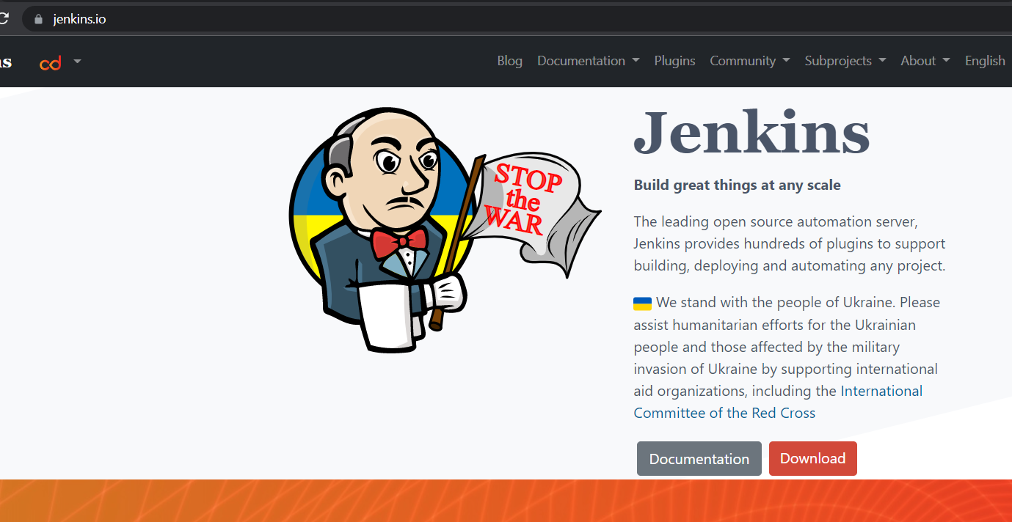
Open the Browser enter jenkins.io & select the Jenkins.io.
To install Jenkins

Slide 4
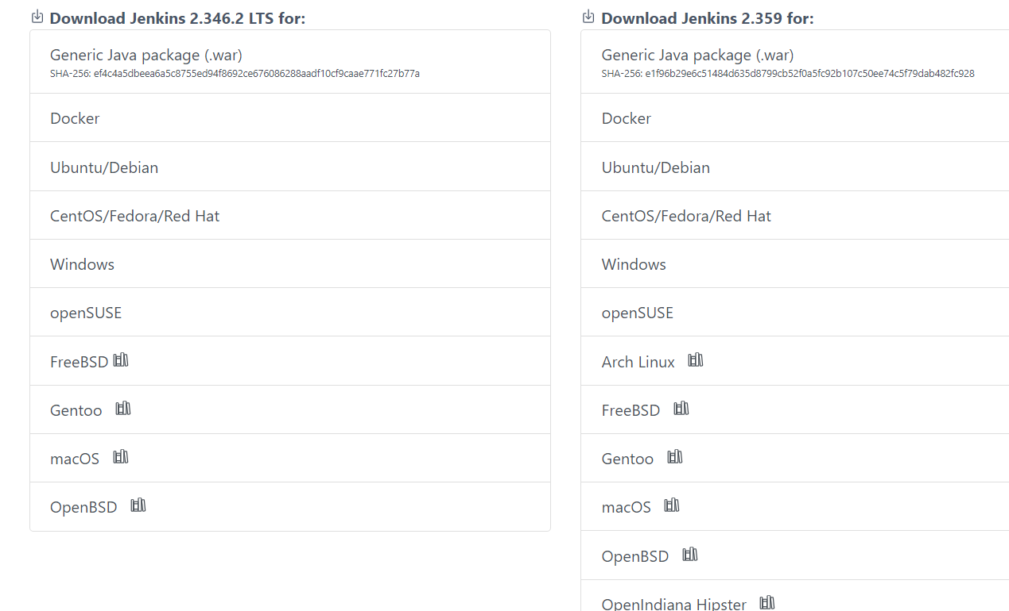
Click on windows.
Click on windows

Slide 5
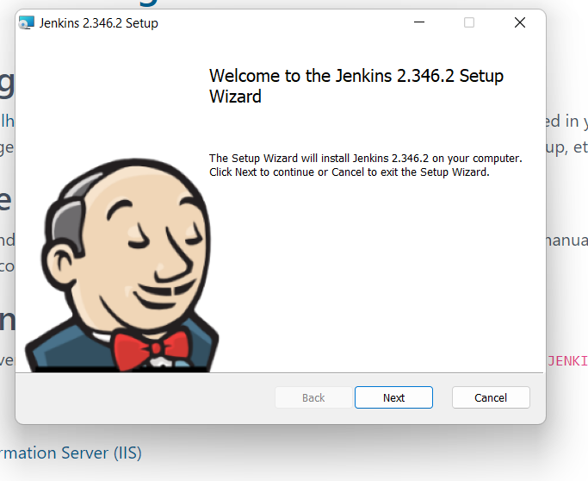
Open the downloads & select the jenkins click on next.
Click on next

Slide 6
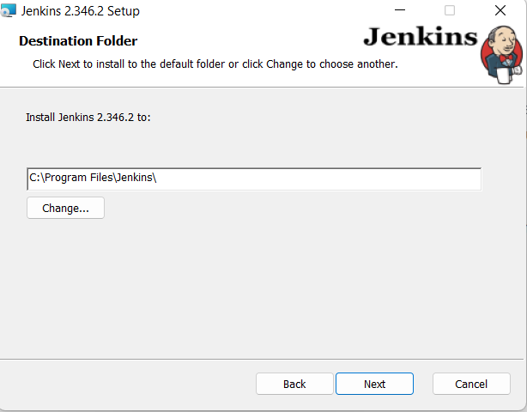
Check the destination path & click on next.
Confirm the path &click on next.

Slide 7
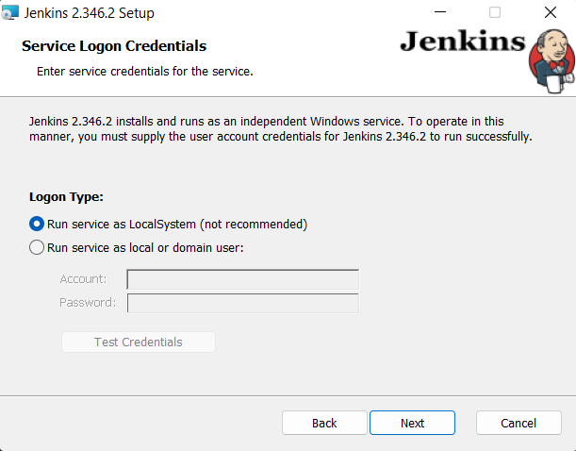
Add the account & password ,click on Test credentials.
Select the run service as localsystem

Slide 8
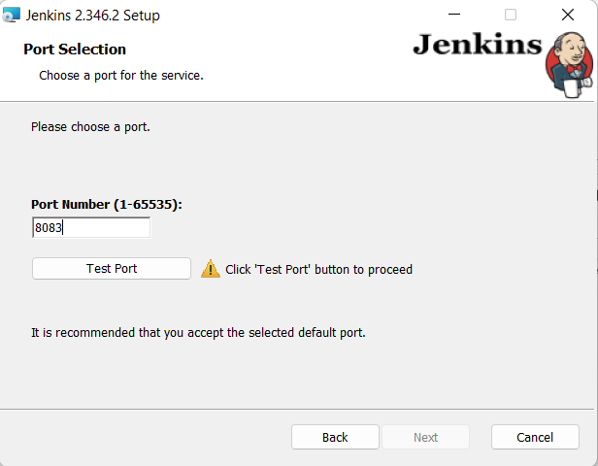
Choose the port or else run the Jenkins in default 8080 port

Slide 9
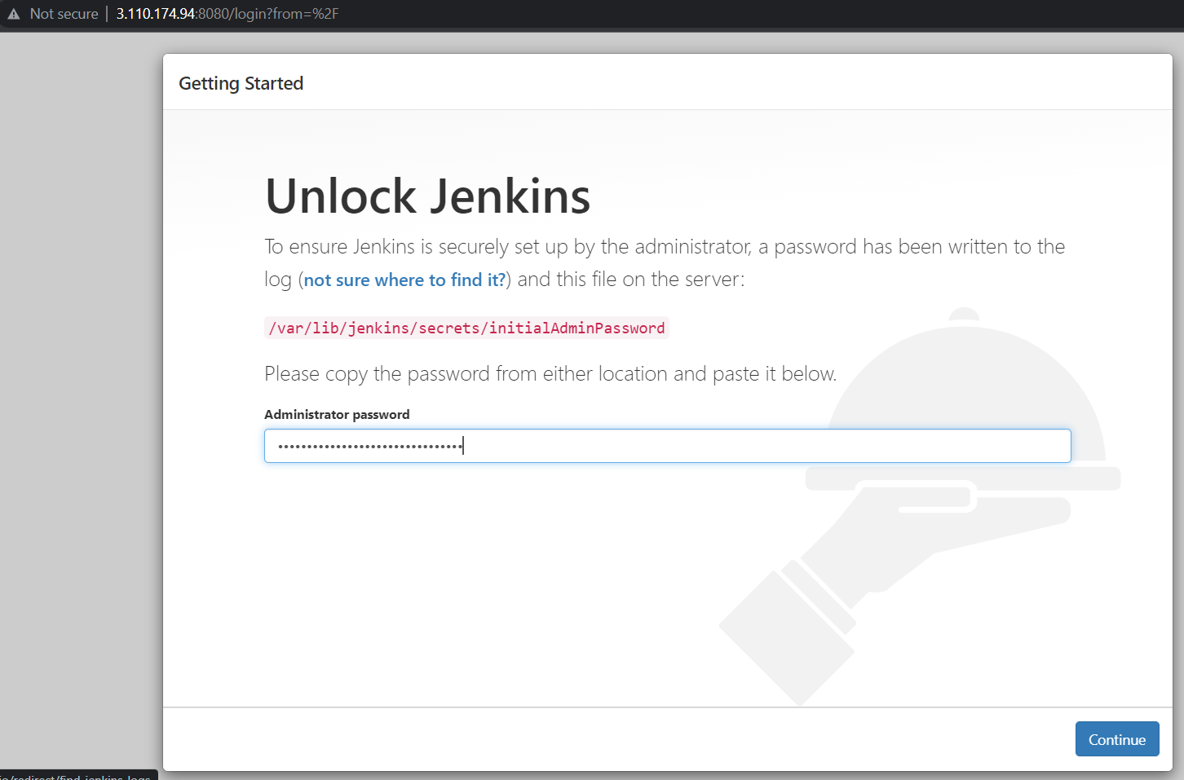
Open with default port .
Copy the path & paste it in the filemanager tab & open it using editors there we will get the password.
Paste the password where we got from the editors.

Slide 10
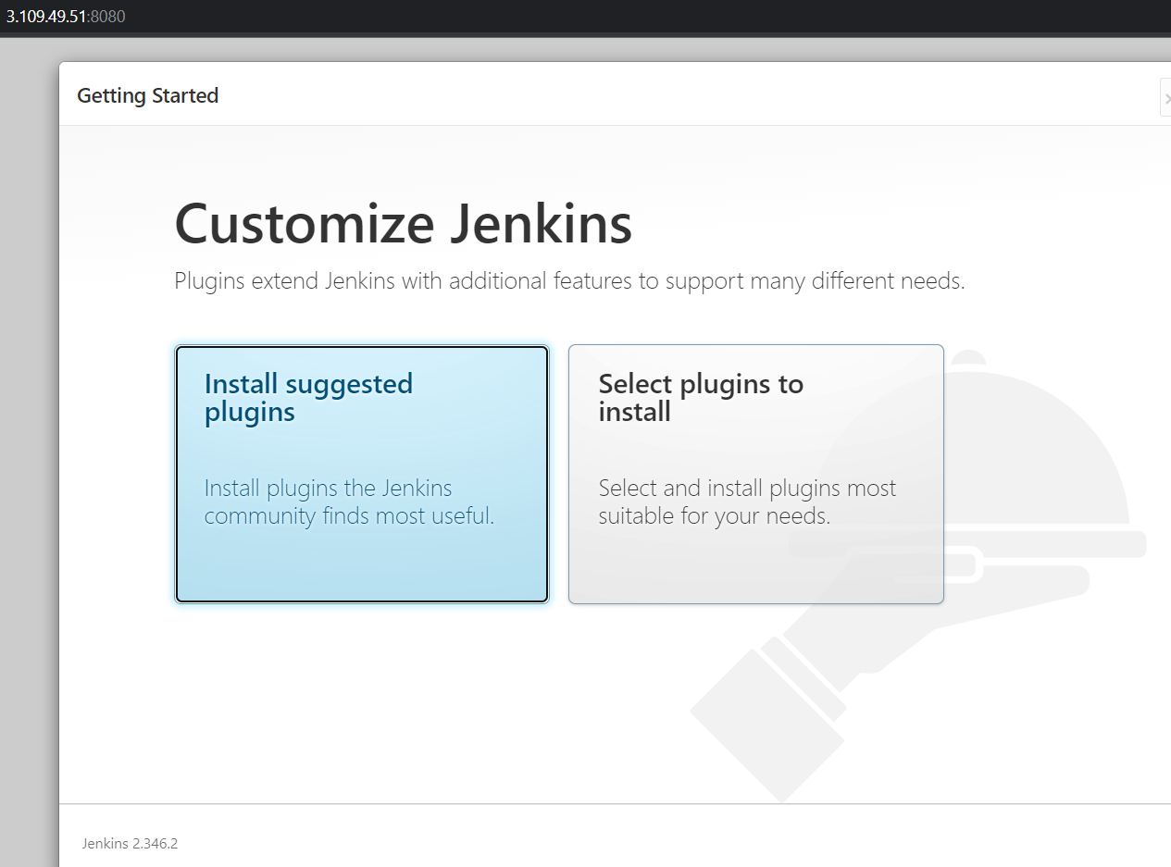
Click on install suggested plugins.

Slide 11
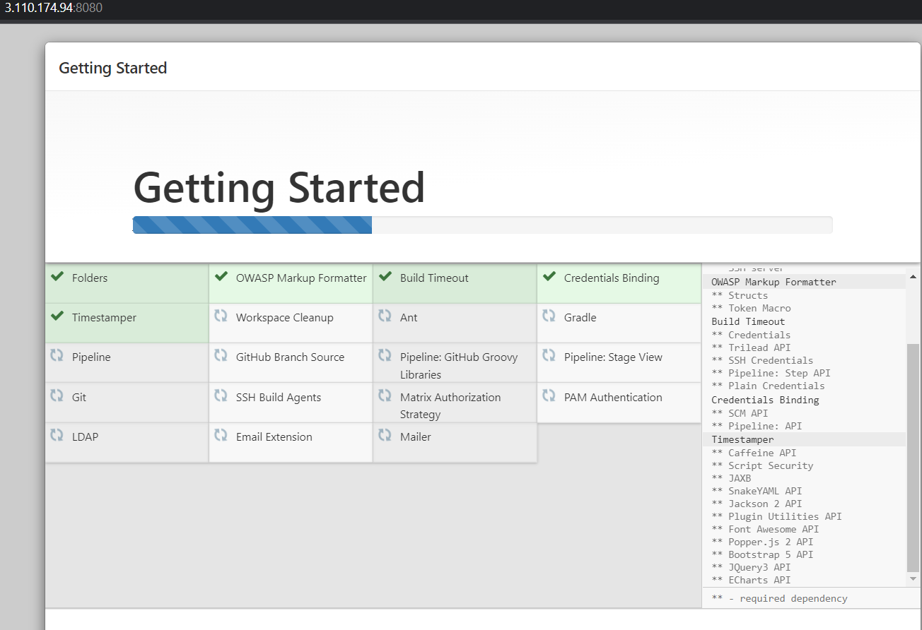
Wait till all the plugins will get download.

Slide 12
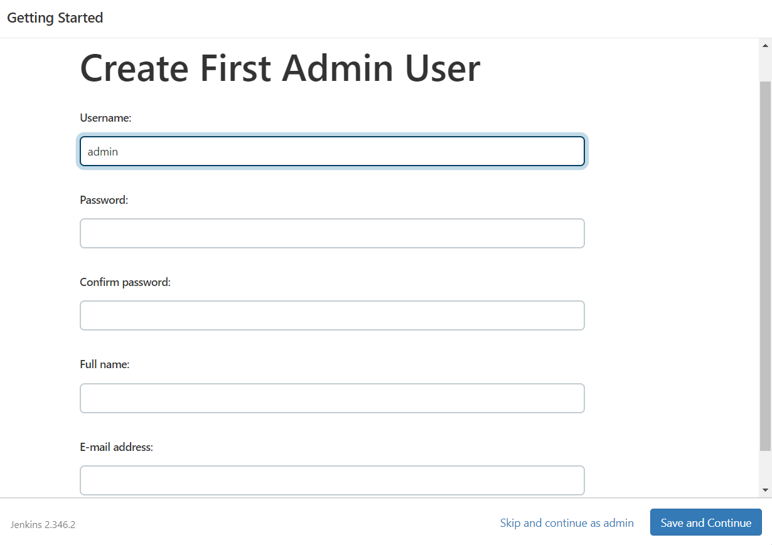
Add the user details & mail id, click on save&continue.

Slide 13
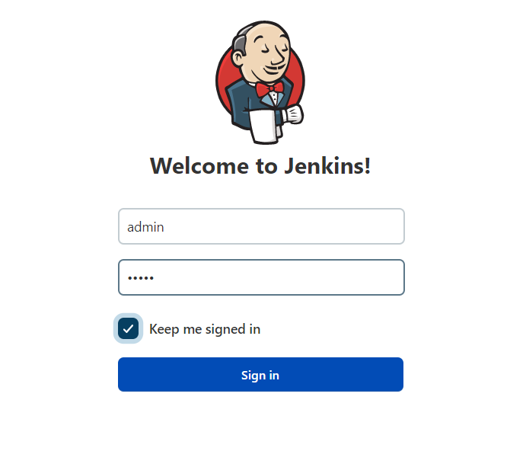
Provide the valid username & password which is created in create first admin user.

Slide 14
JENKINS INSTALLATION IN
AWS-EC2 INSTANCE

Slide 15
JENKINS INSTALLATION IN AWS-EC2 INSTANCE
Launch the aws Linux instance & configure the instance.
Install the Jenkins by running the fallowing commands:
sudo wget -O /etc/yum.repos.d/jenkins.repo https://pkg.jenkins.io/redhat-stable/jenkins.repo
sudo rpm --import https://pkg.jenkins.io/redhat-stable/jenkins.io.key
sudo amazon-linux-extras install epel
sudo yum install java-11*
sudo yum install jenkins

Slide 16
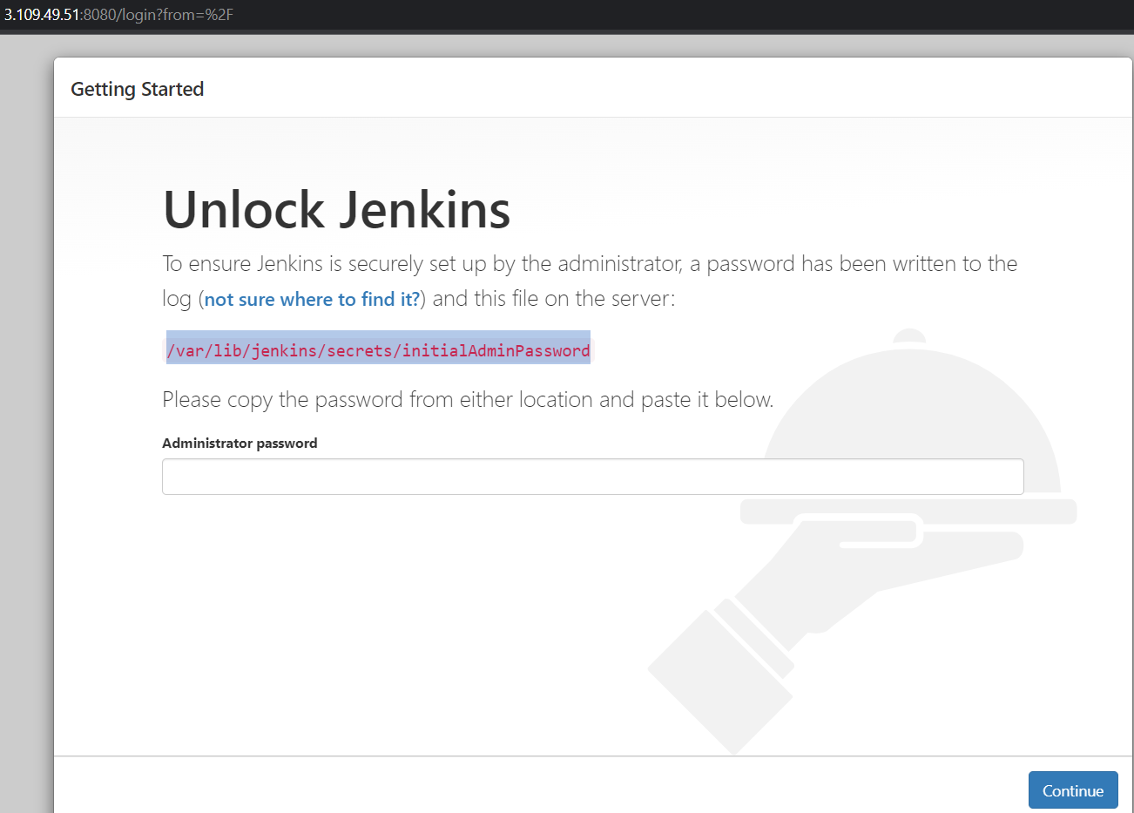
Copy the /var/lib/jenkins/secrets/initialAdminPassword

Slide 17
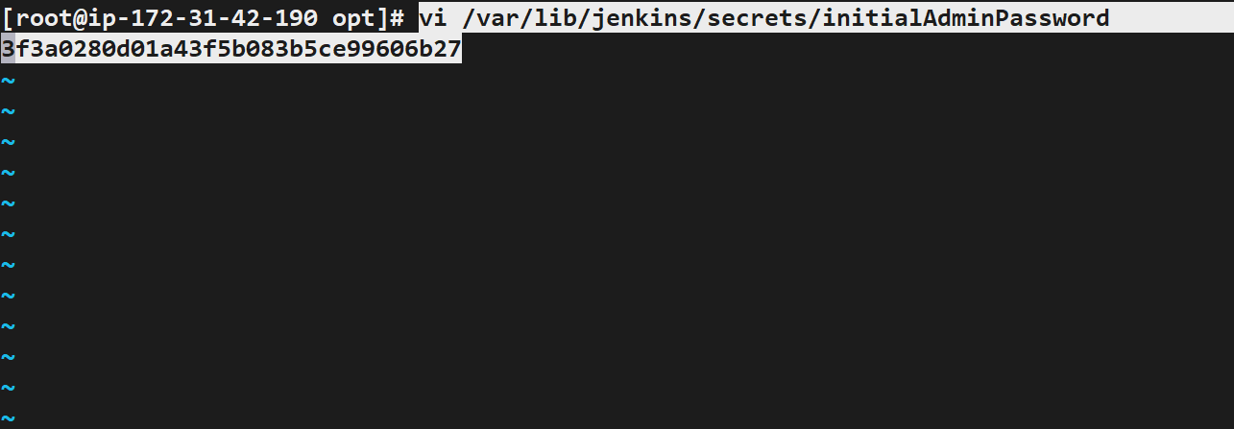
open this path using editors
Vi /var/lib/jenkins/secrets/initialAdminPassword

Slide 18
Click on install suggested plugins.

Slide 19
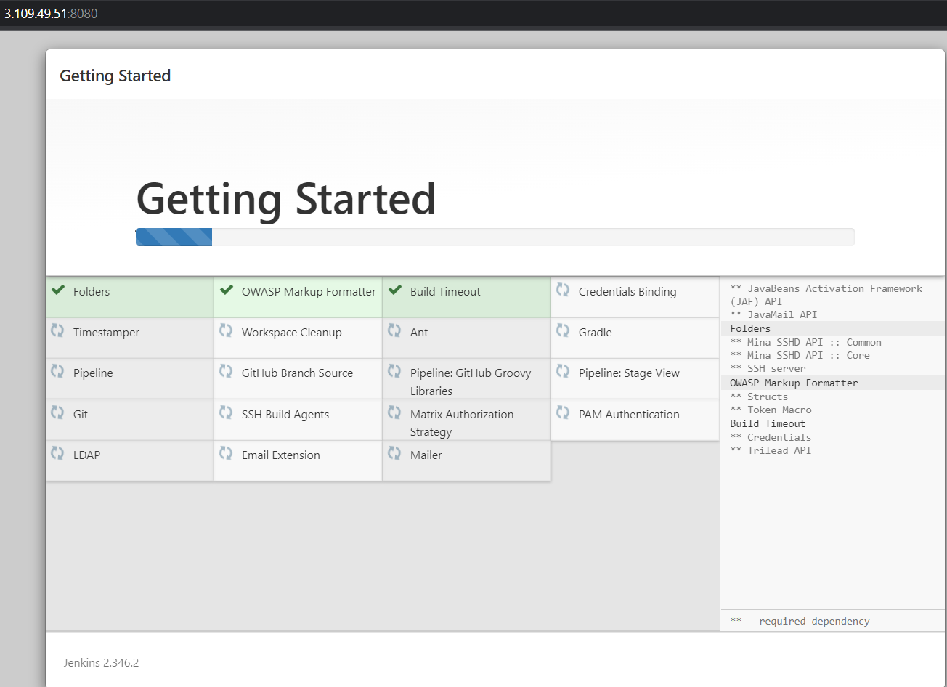
Wait till the plugins get install.

Slide 20
Add the user details & mail id, click on save&continue.

Slide 21
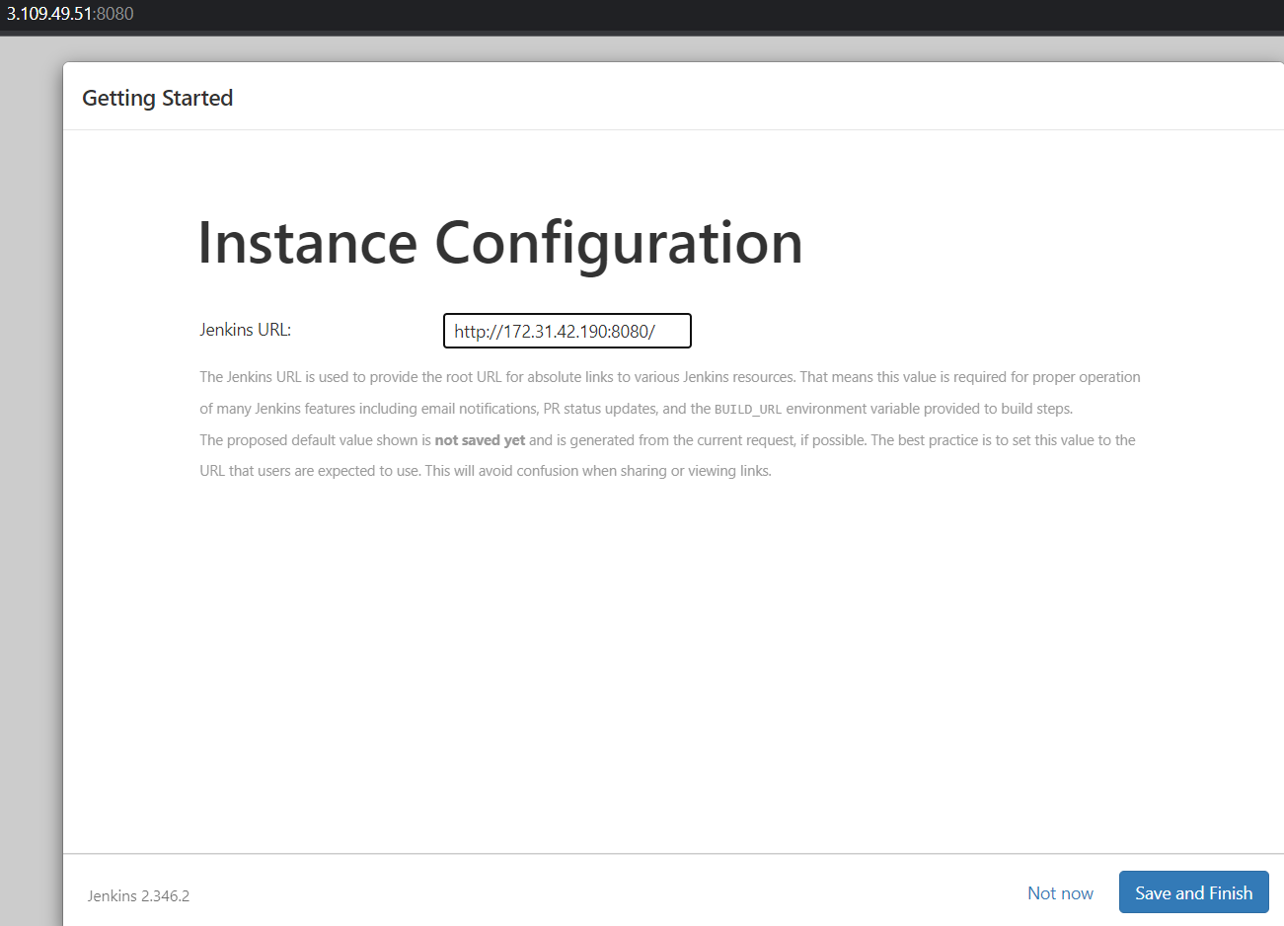
Add the instance IP along with port.

Slide 22
Provide the valid username & password which is created in create first admin user.

Slide 23
CONFIGURATION WITH JENKINS

Slide 24
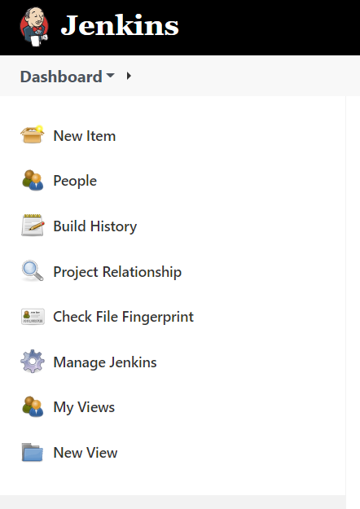
After the installation we will get the dashboard, click on new item.
Click on new item to create the new job.

Slide 25
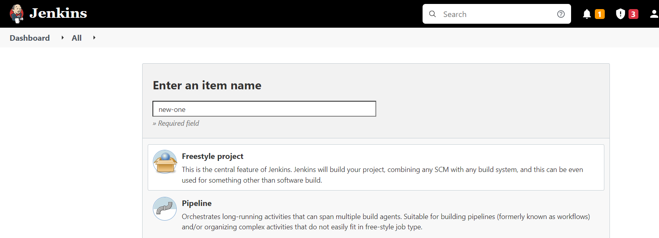
Enter the name for job & select the freestyle project.
Choose the free style project for sample projects.

Slide 26
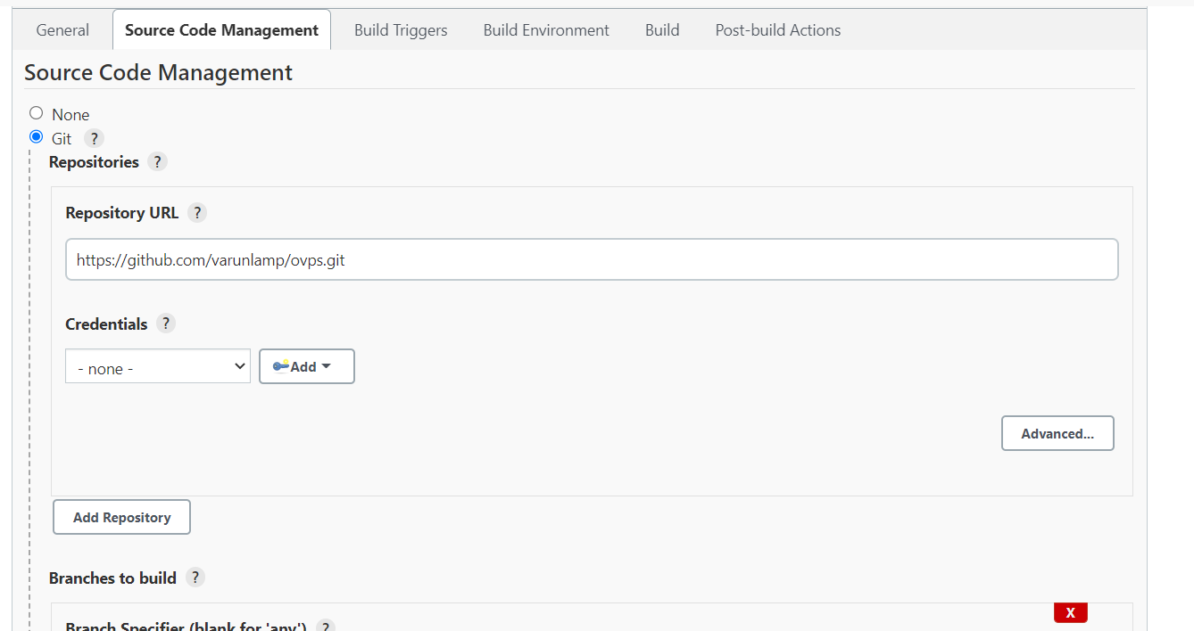
Select the git radio button & provide the github repository url & add the branch.

Slide 27
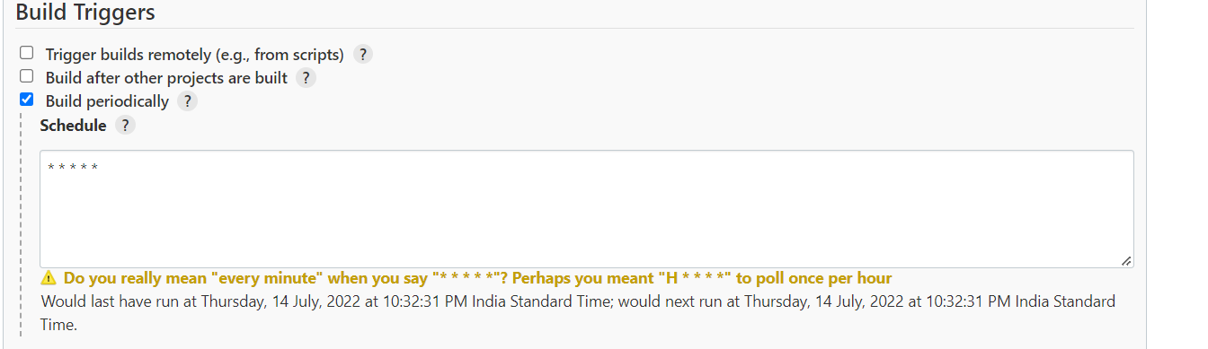
Build periodically
Select the build periodically check box for build the job periodically.

Slide 28
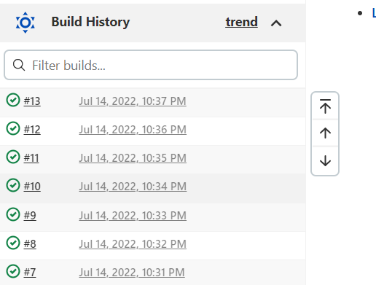
Build is happening based the cron job provided in build periodically.

Slide 29
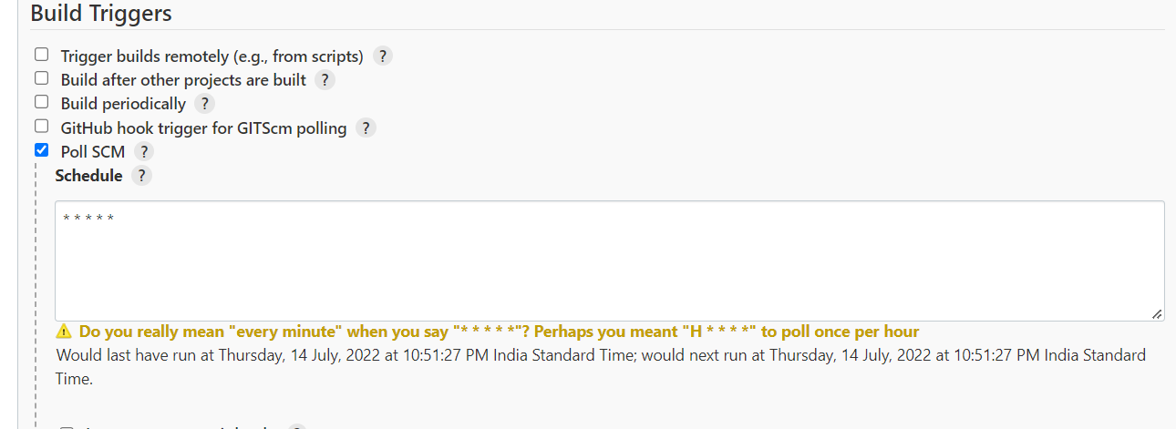
Poll SCM
When ever the changes in scm repository it will build or else it will check the repository periodically.

Slide 30
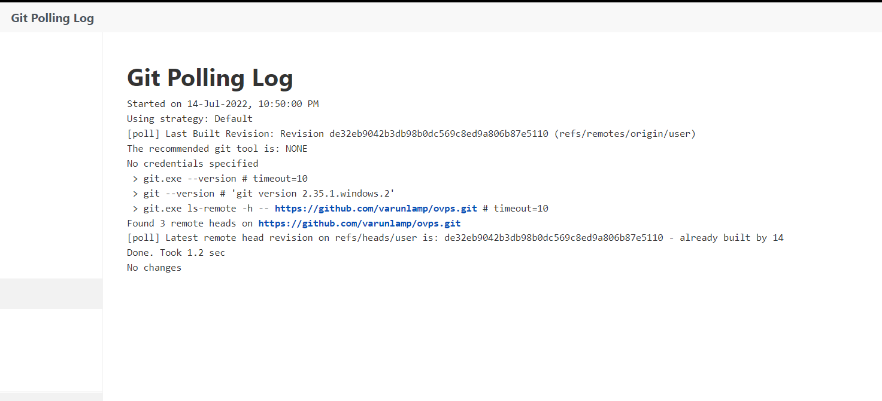
It will trigger the build periodically if any change in repository then only it will build or else it will not build.

Slide 31
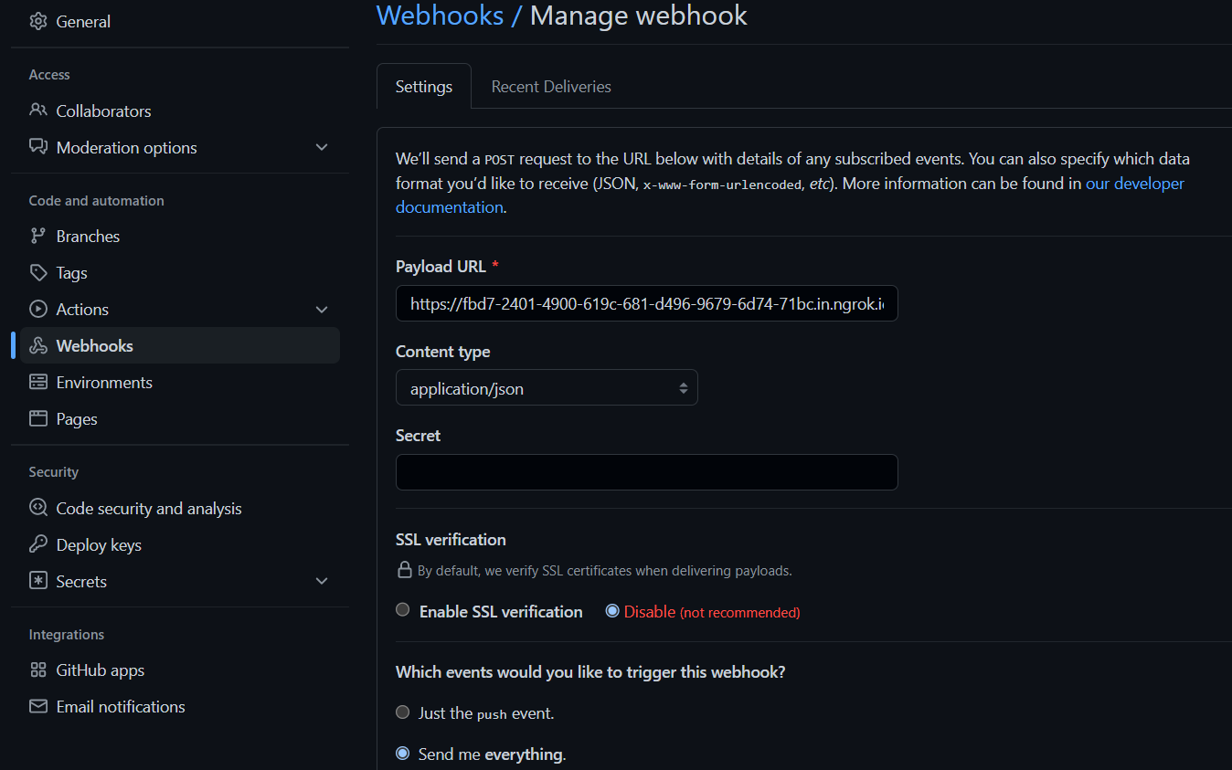
Webhook in local system using ngrok
Add the Jenkins url in payload url /github-webhook/.

Slide 32
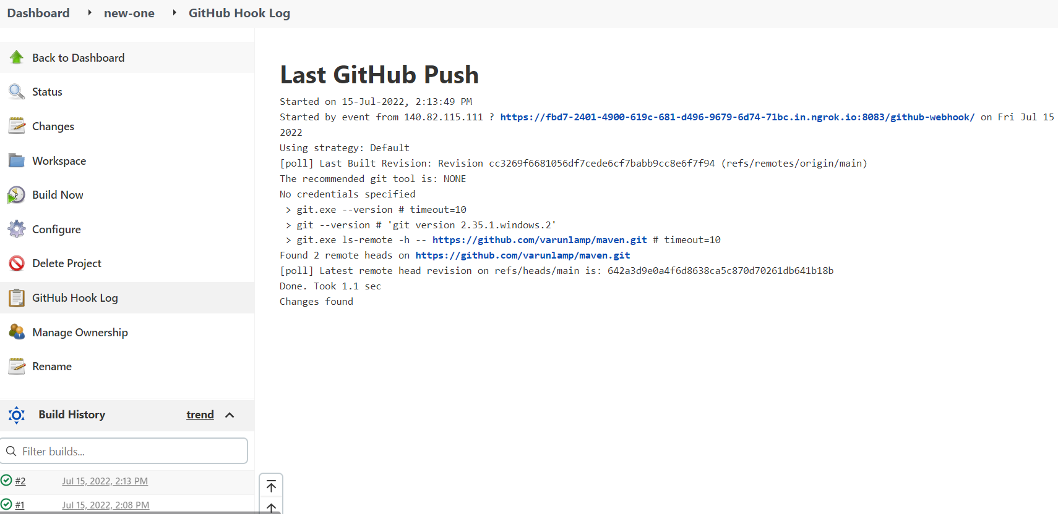
Click on github hook log for build details.

Slide 33
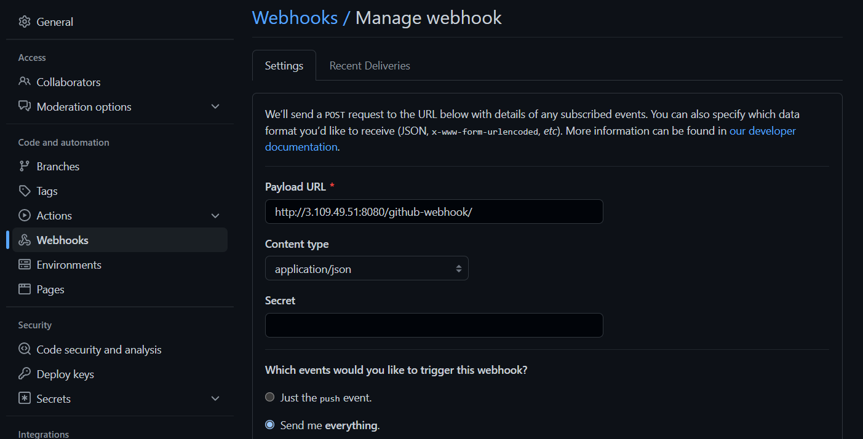
Webhook in EC2 instance
Add the Jenkins url in payload url /github-webhook/.

Slide 34
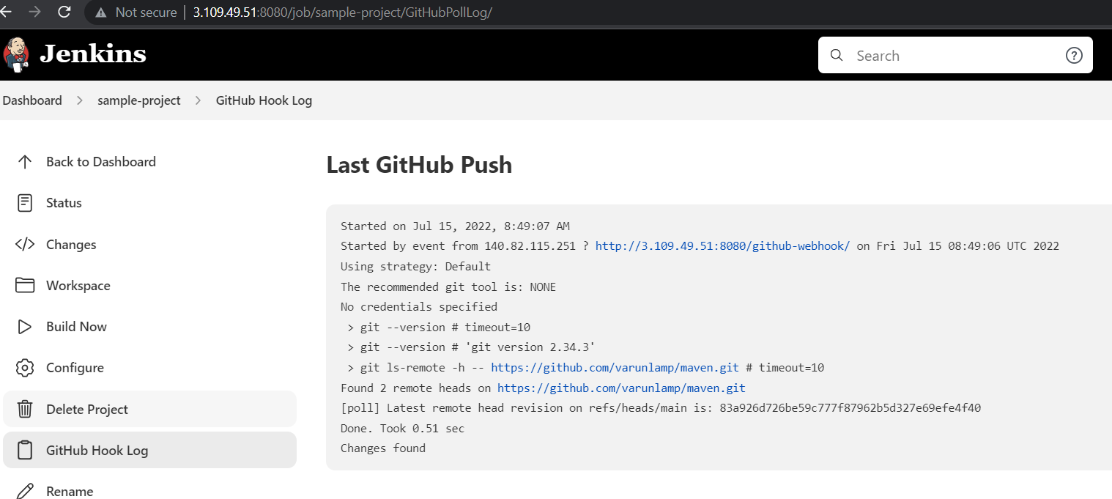
github hook log for build details.

Slide 35
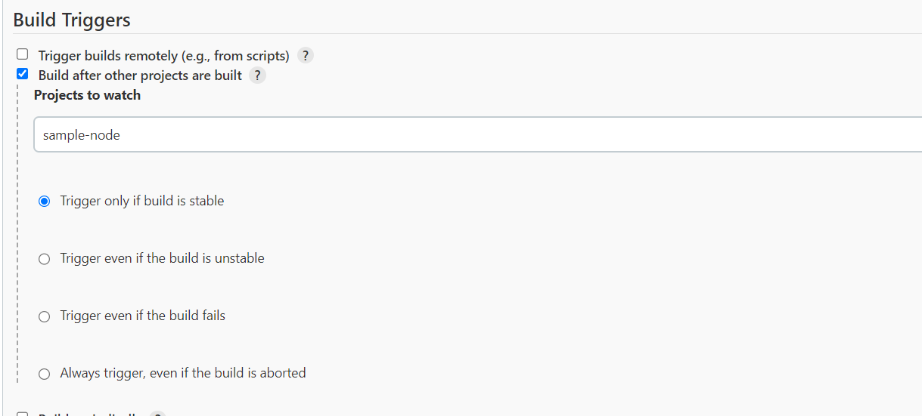
Select the build after other projects are built for upstream job and choose the job for upstream.
Upstream job

Slide 36
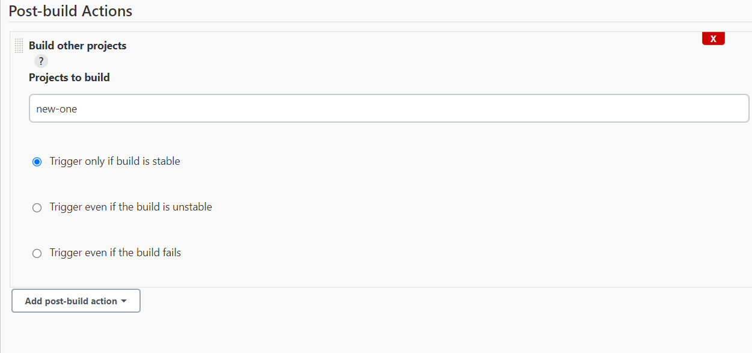
Downstream job
Click on add post-build action & choose the build other projects for downstream job & add the downstram job.

Slide 37
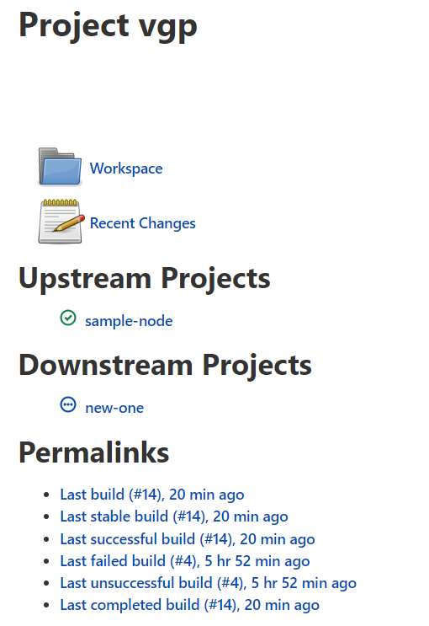
Information about the builds/jobs.

Slide 38
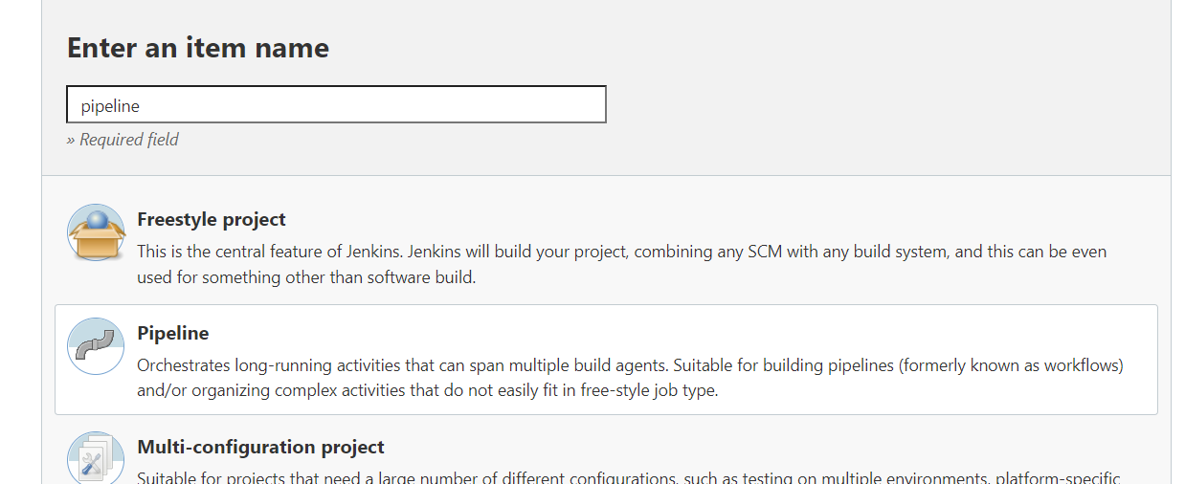
Choose the pipeline for building pipelines

Slide 39
Groovy script for building pipeline
pipeline {
agent any
tools {
maven 'MAVEN-HOME'
}
stages {
stage ('compile') {
steps {
bat "mvn compile"
}
}
stage ('test') {
steps {
bat "mvn test"
}
}
stage ('package') {
steps {
bat "mvn package"
}
}
stage ('Build') {
steps {
bat "mvn install"
}
}
}
}

Slide 40
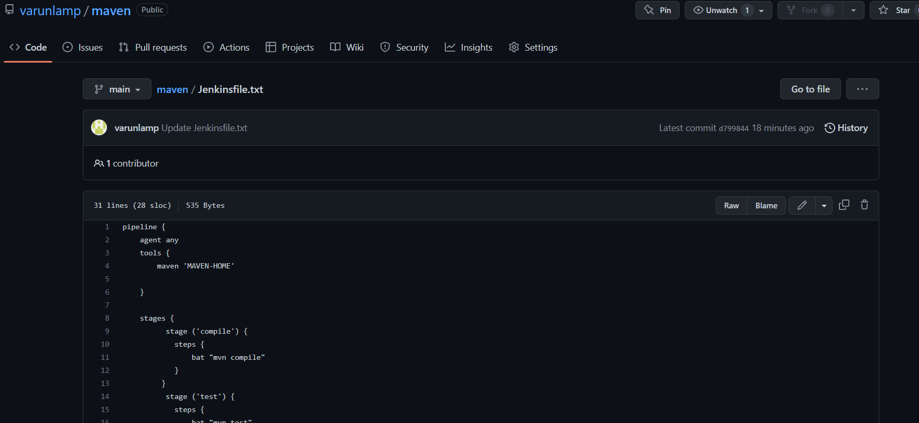
Add the Jenkins pipeline in github

Slide 41
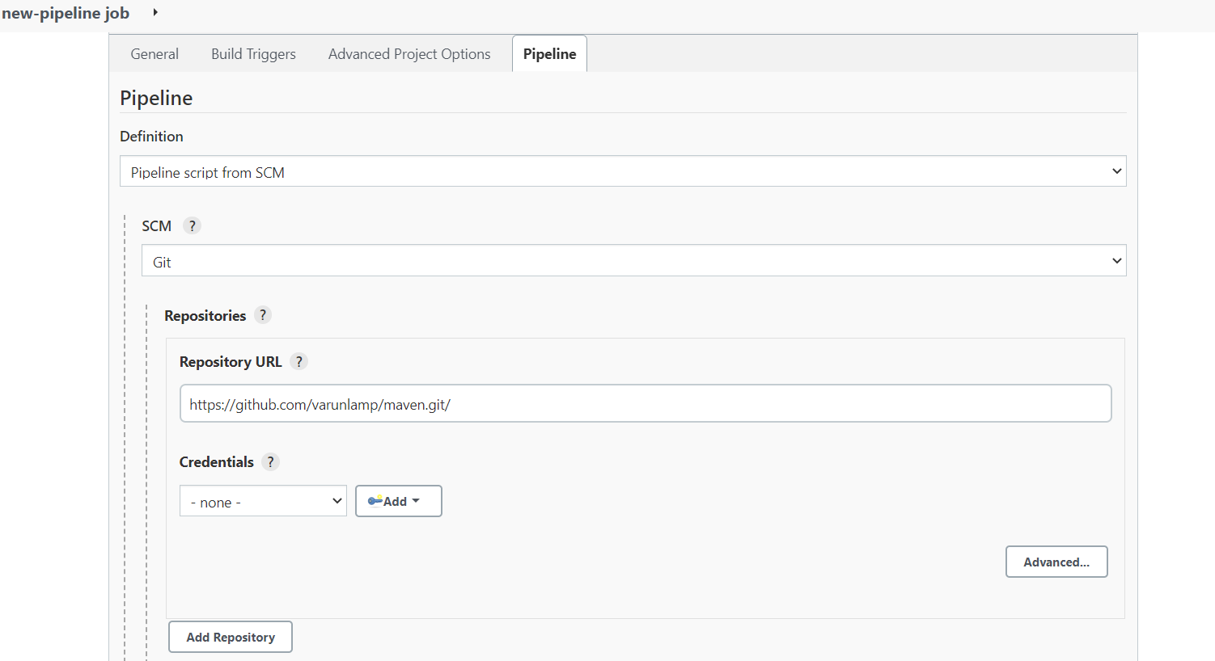
Choose the pipeline script from scm
Provide the github repository url where Jenkins file is present

Slide 42
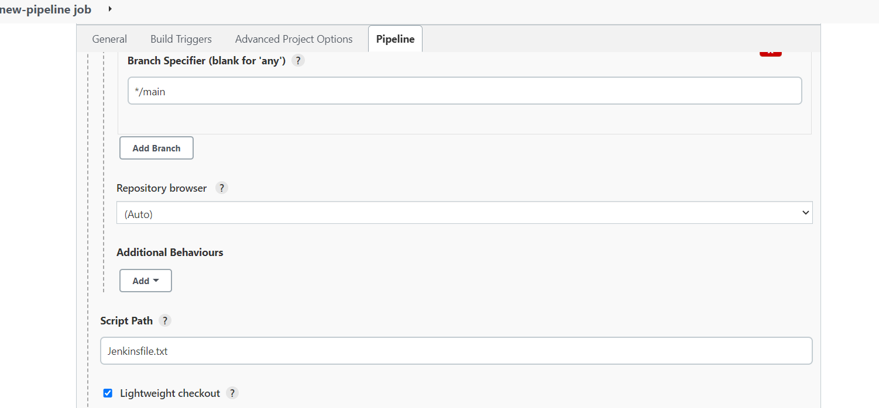
Provide the filename.

Slide 43
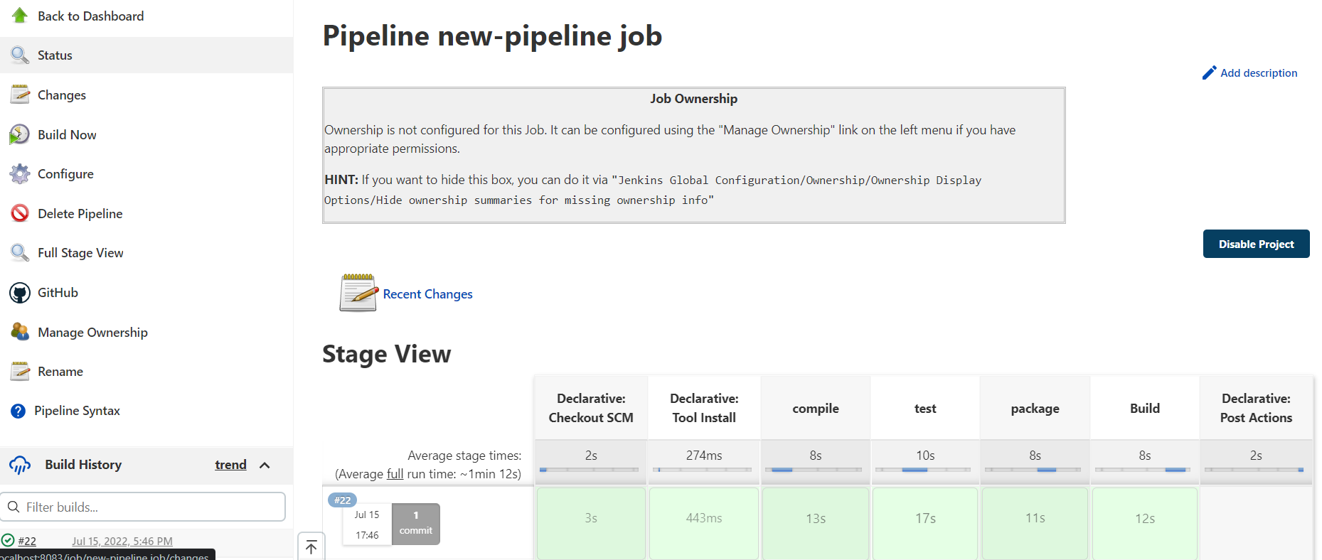
It will show the result in pipeline

Slide 44
User management

Slide 45
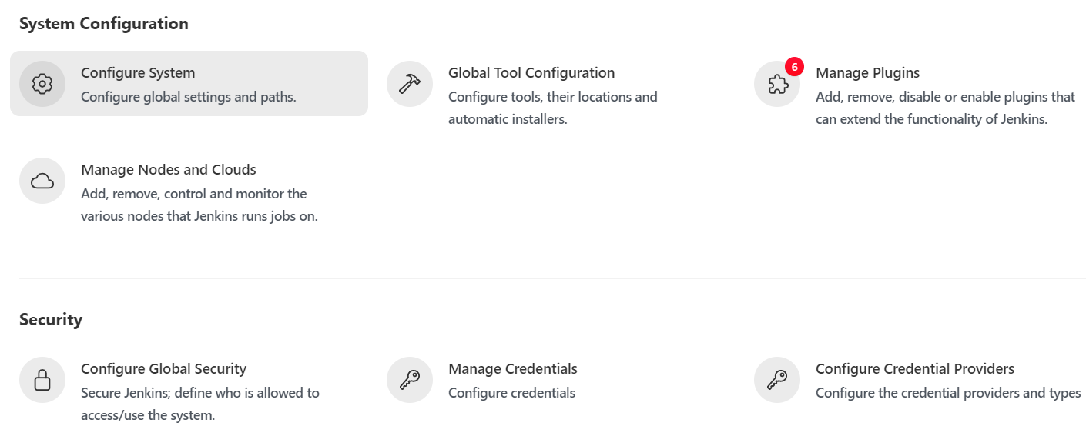
Click on manage Jenkins & choose the configure system.

Slide 46
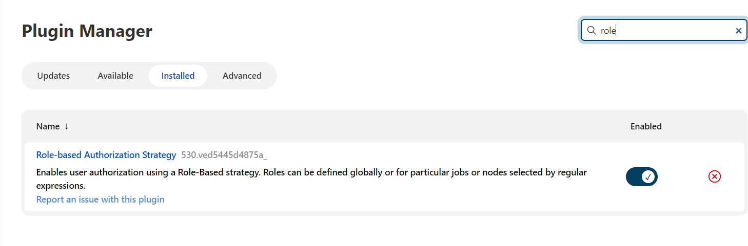
Install the role-based authorization strategy plugin for user management.

Slide 47
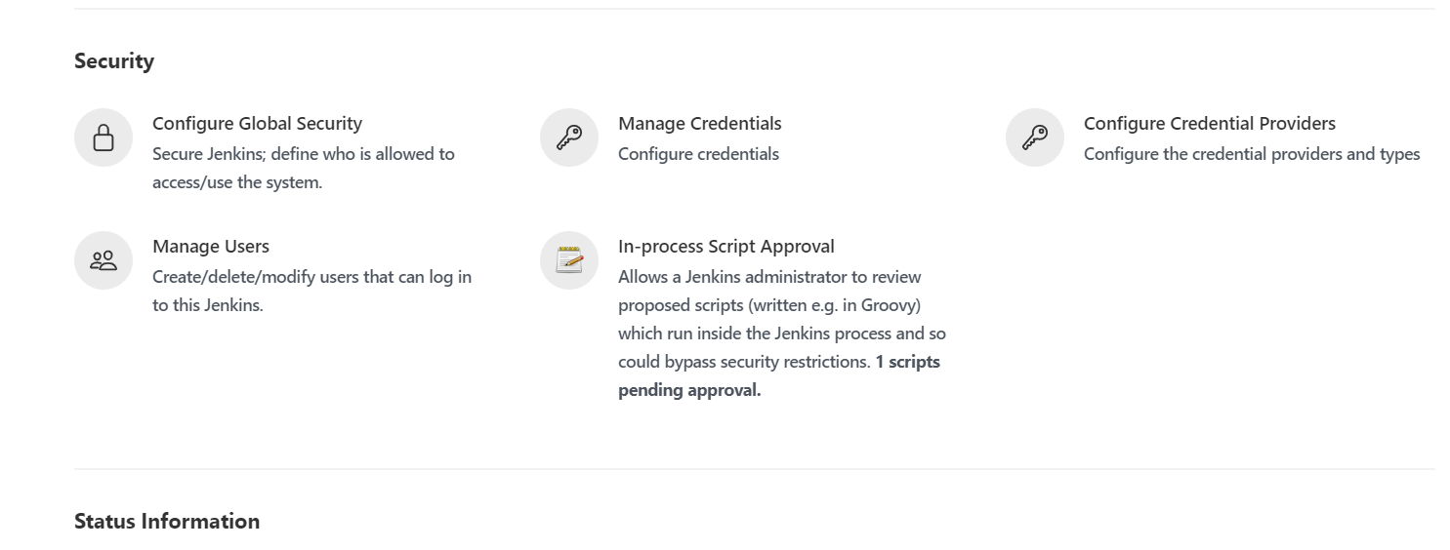
Click on manage users for adding & managing the users.

Slide 48
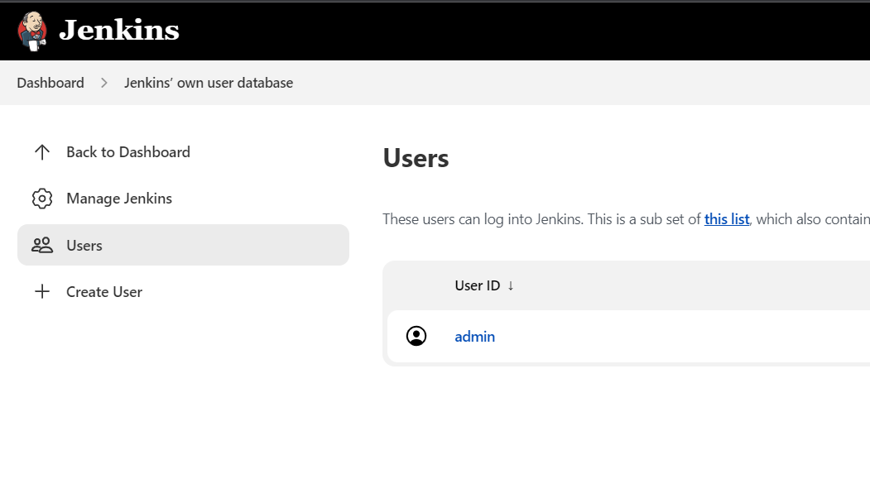
Click on users for the how many users are created

Slide 49
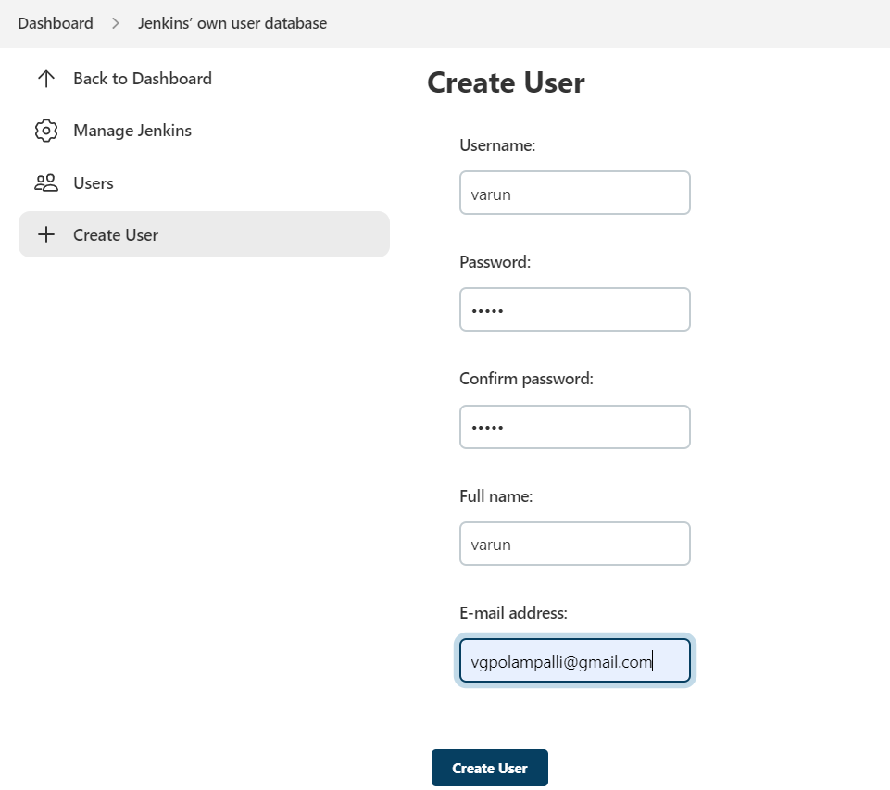
Click on create user for creating the user.
Click on create user after adding the user details.

Slide 50
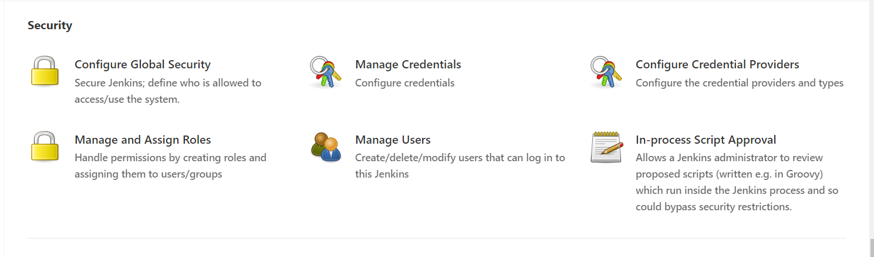
Click on configure global security for the defining the access.

Slide 51
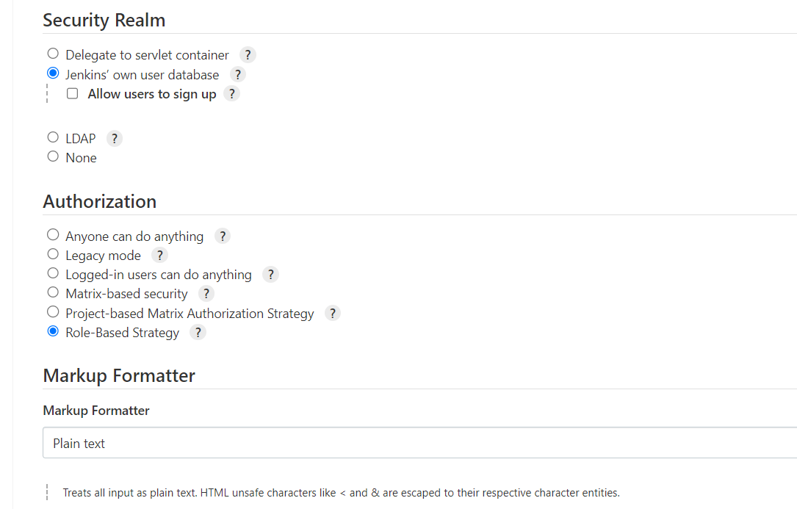
Choose the role based strategy for giving the permissions to users which are created by admin.

Slide 52
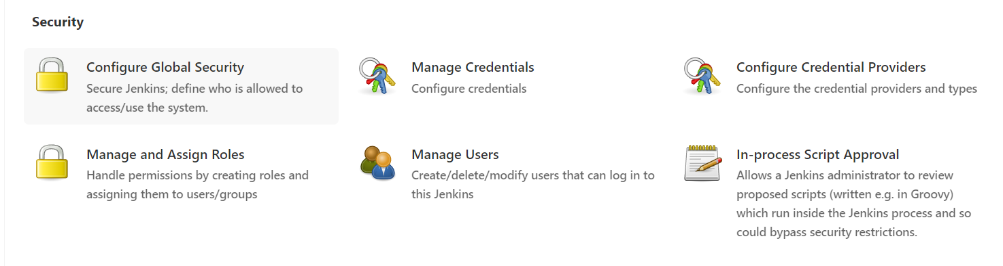
Click on manage & assign roles for managing the roles.

Slide 53
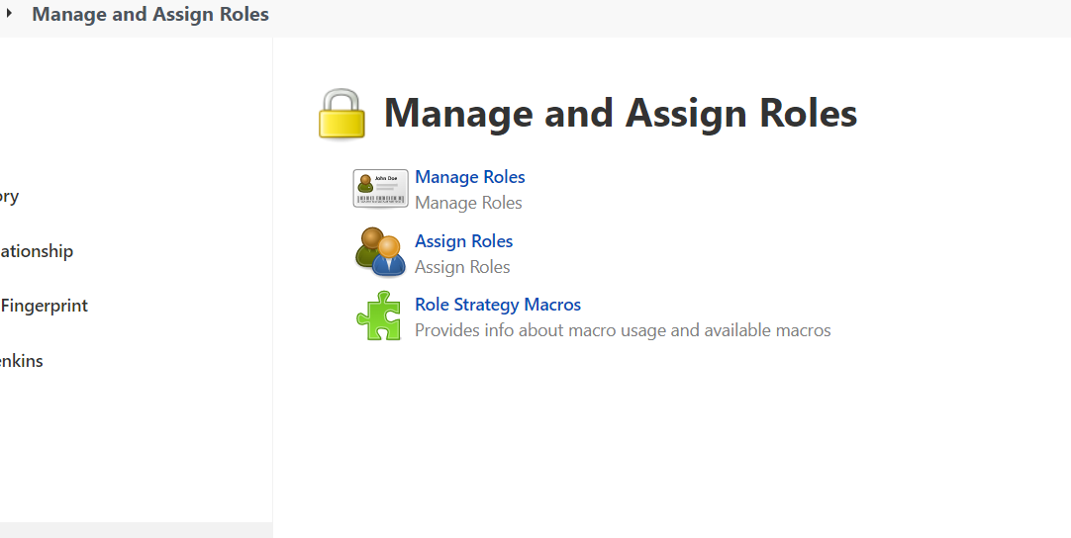
Click on manage roles for adding the users.

Slide 54
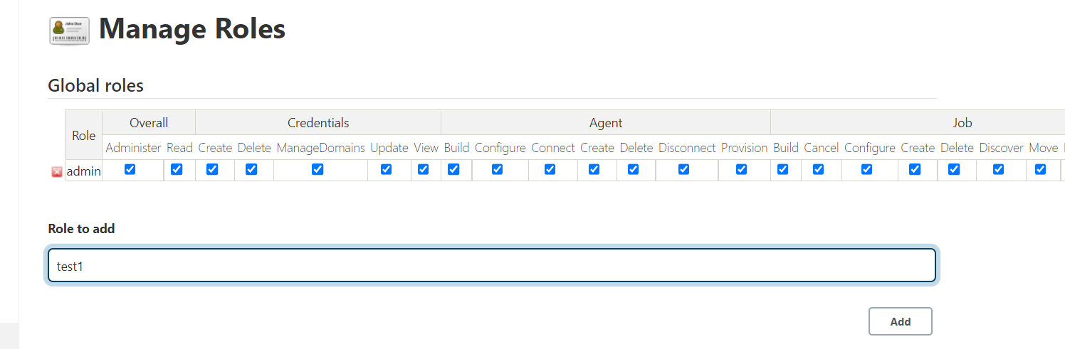
Add the role & give the permissions for the role.

Slide 55
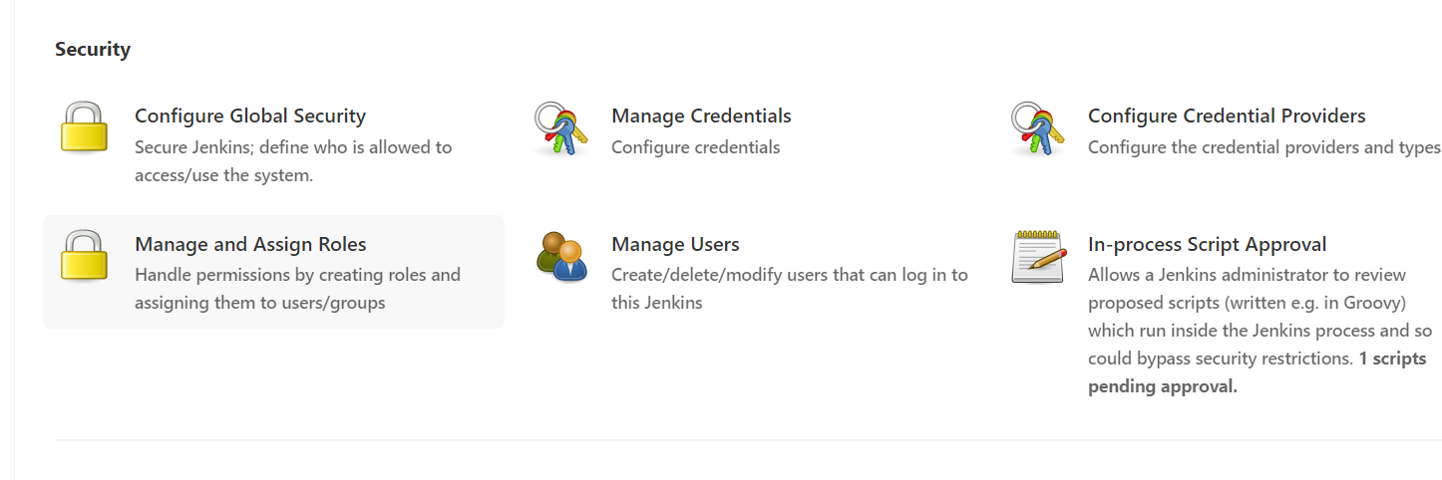
Click on manage & assign roles .

Slide 56
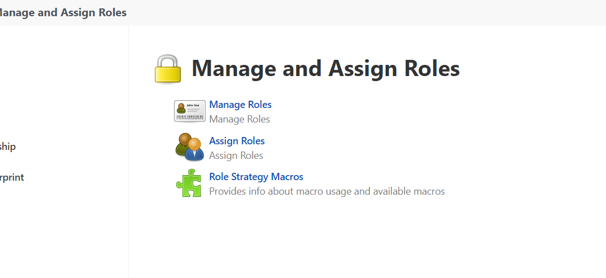
Click on assign roles for assigning the roles.

Slide 57
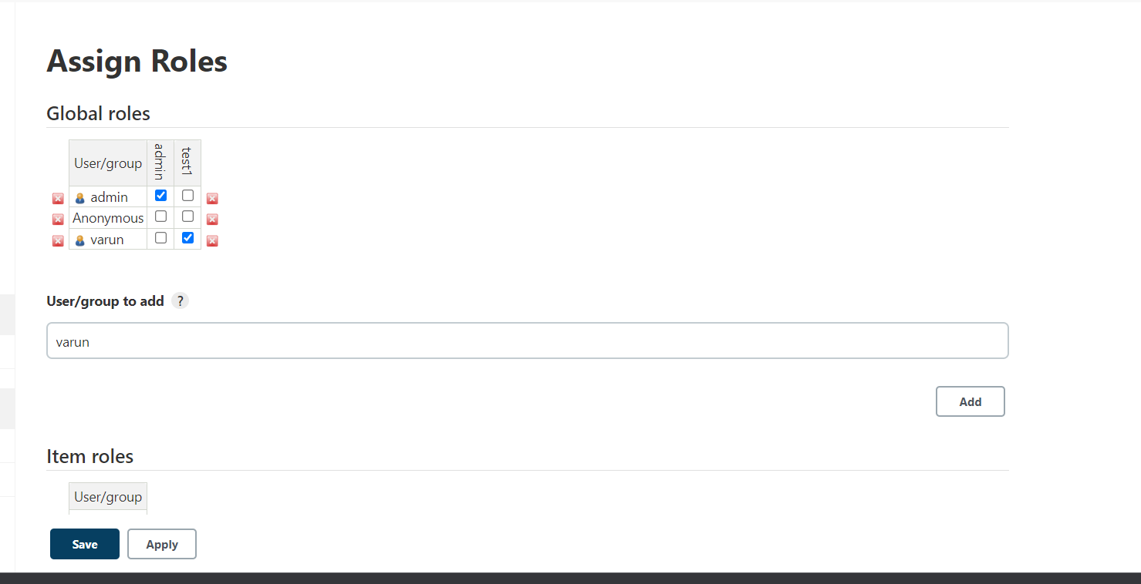
Provide the user & click on add,assing the role to user.

Slide 58
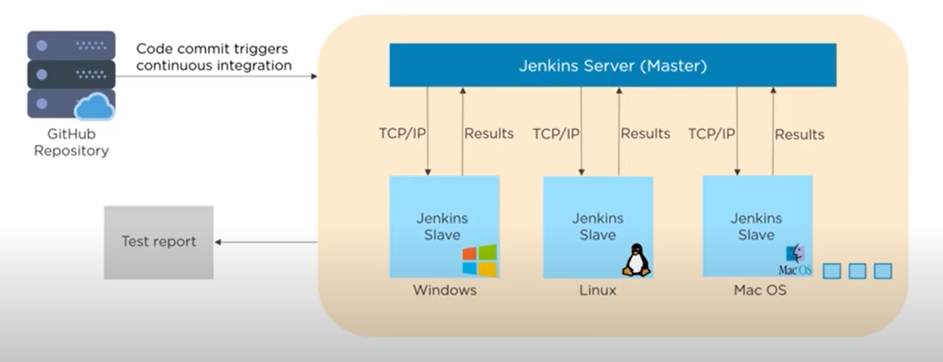
Master slave architecture

Slide 59
Jenkins Master
The main server of Jenkins is the Jenkins Master. It is a web dashboard which is nothing but powered from a war file. By default it runs on 8080 port. With the help of Dashboard, we can configure the jobs/projects but the build takes place in Nodes/Slave. By default one node (slave) is configured and running in Jenkins server. We can add more nodes using IP address, user name and password using the ssh, jnlp or webstart methods.

Slide 60
Jenkins Slave
Jenkins slave is used to execute the build jobs dispatched by the master. We can configure a project to always run on a particular slave machine, or particular type of slave machine, or simple let the Jenkins to pick the next available slave/node.

Slide 61
The server's job or master's job is to handle:
Scheduling build jobs.
Dispatching builds to the nodes/slaves for the actual execution.
Monitor the nodes/slaves (possibly taking them online and offline as required).
Recording and presenting the build results.
A Master/Server instance of Jenkins can also execute build jobs directly.

Slide 62
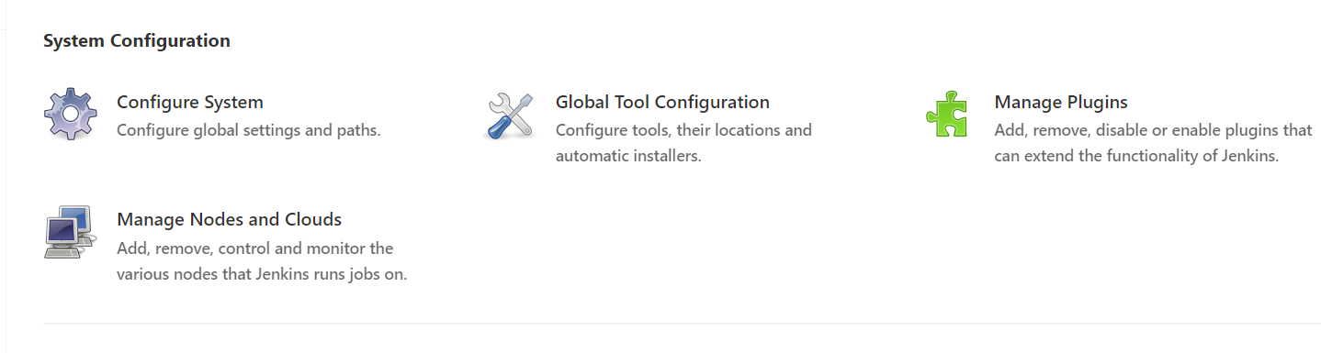
Click on manage nodes & clouds.

Slide 63
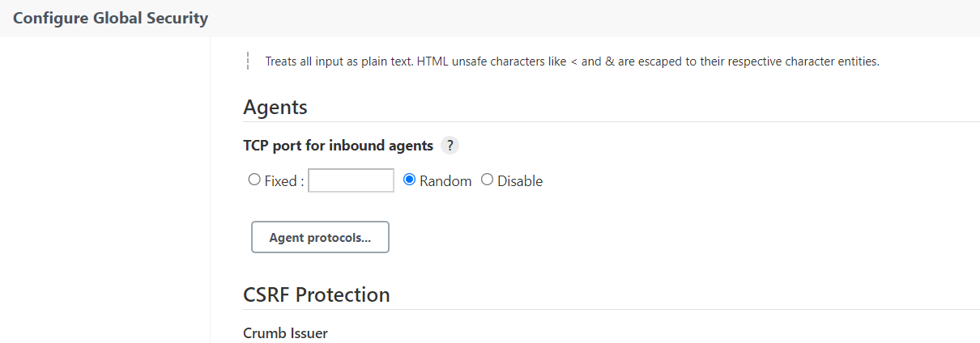
Open the configure global security for allowing the random port.

Slide 64

Click on new node for adding the new node.

Slide 65

Provide the node name for creating the node
Choose the permanent agent.

Slide 66

Configure the node details by providing all vaild details like remote root directory path.
Give the path for node

Slide 67

Configure the details

Slide 68

Now node is created click on slave for slave configuration.

Slide 69

Install the agent.jar file in node location

Slide 70

Agent.jar file is downloaded in slave location.

Slide 71

Run the command prompt from the agent.jar file location & paste the command which is copied in agent slave & run the command.

Slide 72

Choose the restrict where this project can be run & provide the slave node label.

Slide 73
Thank you

